Slide 1
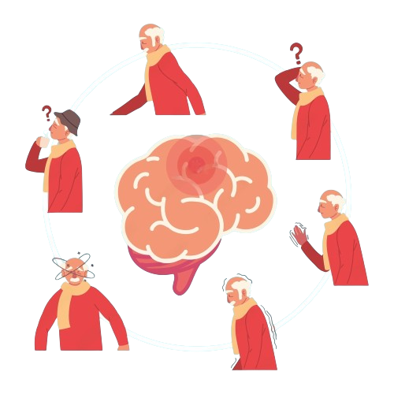
Multi-Modal Approach for Parkinson’s Disease Detection, Classification, and Management
B. K. Birla Institute of engineering and technology
June, 2024

Slide 2


OUR TEAM
IRA GOYAL
B. TECH CS-1
20EBKCS050
ISHAN AGRAWAL
B. TECH A.I.
20EBKAI011

Slide 3

WHAT IS PARKINSON’S?
Parkinson's disease is a progressive neurodegenerative disorder that affects movement. It occurs when nerve cells in a part of the brain called the substantia nigra die or become impaired. These nerve cells produce dopamine, a neurotransmitter that helps regulate movement and coordination. As dopamine levels decrease, it leads to the symptoms associated with Parkinson's disease.
Motor Symptoms
Neurodegeneration
Non-Motor Symptoms
It primarily affects movement, causing tremors, stiffness, slowness of movement (bradykinesia), and balance problems.
It involves the gradual degeneration of dopamine-producing neurons in the substantia nigra, a region of the brain critical for controlling movement.
It also includes non-motor symptoms such as depression, cognitive impairment, sleep disturbances, and autonomic dysfunction (e.g., blood pressure regulation and digestion issues).

Slide 4
IMPORTANCE OF EARLY DETECTION AND MANAGEMENT
Personalized Care Plans
Enhanced Treatment Options
Research and Development
Slowing Disease Progression
Psychological Benefit
Reducing Healthcare Costs
Improving Quality of Life

Slide 5
PROBLEM STATEMENT
Parkinson's disease (PD) presents a complex array of symptoms that severely affect the quality of life of individuals afflicted by it. One of the hallmark manifestations of PD is the deterioration of motor function, encompassing a spectrum of issues ranging from tremors and bradykinesia to postural instability and gait disturbances. These motor symptoms often lead to debilitating consequences, including falls, diminished dexterity, and compromised mobility. Among the distinct motor impairments associated with PD, handwriting difficulties, medically termed "micrographia," pose a significant challenge. Handwriting, being a fundamental aspect of communication and daily functioning, becomes progressively impaired as the disease advances. This deterioration not only affects the legibility of written communication but also reflects the underlying motor control deficits and fine motor skill impairments characteristic of PD. Furthermore, speech impairment, commonly referred to as "dysarthria," emerges as another debilitating aspect of PD. Individuals with PD often experience slurred speech, reduced volume, monotone voice, and articulation difficulties, which not only hinder effective communication but also contribute to social withdrawal and diminished quality of life. Moreover, the manifestation of tremors, particularly in the hands and limbs, exacerbates the challenges faced by individuals with PD. Addressing the multifaceted challenges posed by PD requires a comprehensive understanding of the interplay between motor and non-motor symptoms, as well as their impact on daily functioning and quality of life. By elucidating the intricate mechanisms underlying these challenges, advancements in therapeutic interventions, management strategies, and supportive care can be developed to alleviate the burden experienced by individuals living with PD and enhance their overall quality of life.

Slide 6

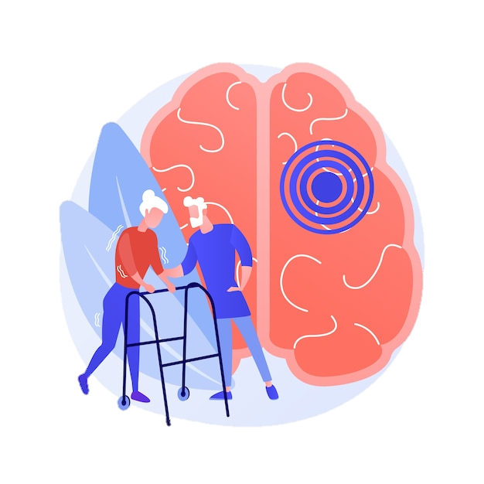
Project Description
This project seeks to address these limitations by developing an integrated framework that harnesses the power of advanced technologies and methodologies to redefine PD management. By leveraging artificial intelligence (AI), machine learning (ML), and image processing technologies, the goal is to enable early detection, accurate classification, and personalized intervention tailored to the specific needs of each patient. This project aims to provide Enhanced safety and quality of life for individuals with PD through real-time monitoring and fall detection mechanisms. Improved early detection and diagnosis of PD, leading to timely intervention and better outcomes for patients. Develop a comprehensive framework for early detection and personalized management of Parkinson’s disease. Utilize handwriting analysis, voice input analysis, and body movement analysis as primary modalities for PD detection and classification.

Slide 7

MVP, Technologies & Algorithms

Slide 8


MINIMAL VIABLE PRODUCT
HOME PAGE
A welcoming header that introduces the user to the application, setting a positive and inviting tone.
Multiple buttons to curate different needs
A button to Initiate fall detect app
Another buttons for moving to handwriting detection
Next button to move to audio based detection
And another button to move to Video based detection
And at last a button to calculate overall stage of the Parkinson's
HANDWRITING ANALYSIS
Utilize Convolutional Neural Networks (CNN) for feature extraction and classification of handwriting patterns.
Train the CNN model on a large dataset of handwritten samples, including those from individuals with PD and healthy controls.
Created a user friendly UI for image clicking and uploading to process and predict on hand writing images.
Include different data like wave pattern and spiral pattern

Slide 9



MINIMAL VIABLE PRODUCT
VOICE INPUT ANALYSIS
Employ XGBoost algorithm for voice input analysis to detect tremors and speech abnormalities indicative of PD.
Extract acoustic features such as pitch, intensity, and formant frequencies from voice recordings.
Train the XGBoost model on a diverse dataset of voice samples collected from individuals with varying stages of PD and healthy controls.
User-friendly interface allows users to record and browse the audio files seemlessly
BODY MOVEMENT ANALYSIS
Utilize MediaPipe framework for body movement analysis to discern bradykinesia and rigidity, key motor symptoms of PD.
Extract skeletal pose features from video recordings of movement tasks using MediaPipe's pose estimation model.
Develop algorithms for real-time assessment of motor symptoms and disease progression.
User-friendly interface allows users to check in real time and also on any existing video files seemlessly

Slide 10


MINIMAL VIABLE PRODUCT
REAL-TIME FALL DETECTION MECHANISM
A user-friendly interface allowing user to feed in any video input from real-time, any IP cam or from local system
Allows user to modify receivers email in settings
Used image processing and KNN algorithm to detect the fall
Utilize computer vision techniques to analyze video streams or webcam feeds for changes in posture indicative of a fall.
Trigger immediate alerts to caregivers or emergency services in case of a fall.

Slide 11





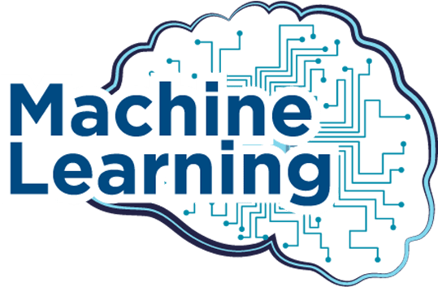




TECHNOLOGIES & ALGORITHMS
MEDIA PIPE
Tkinter

Slide 12
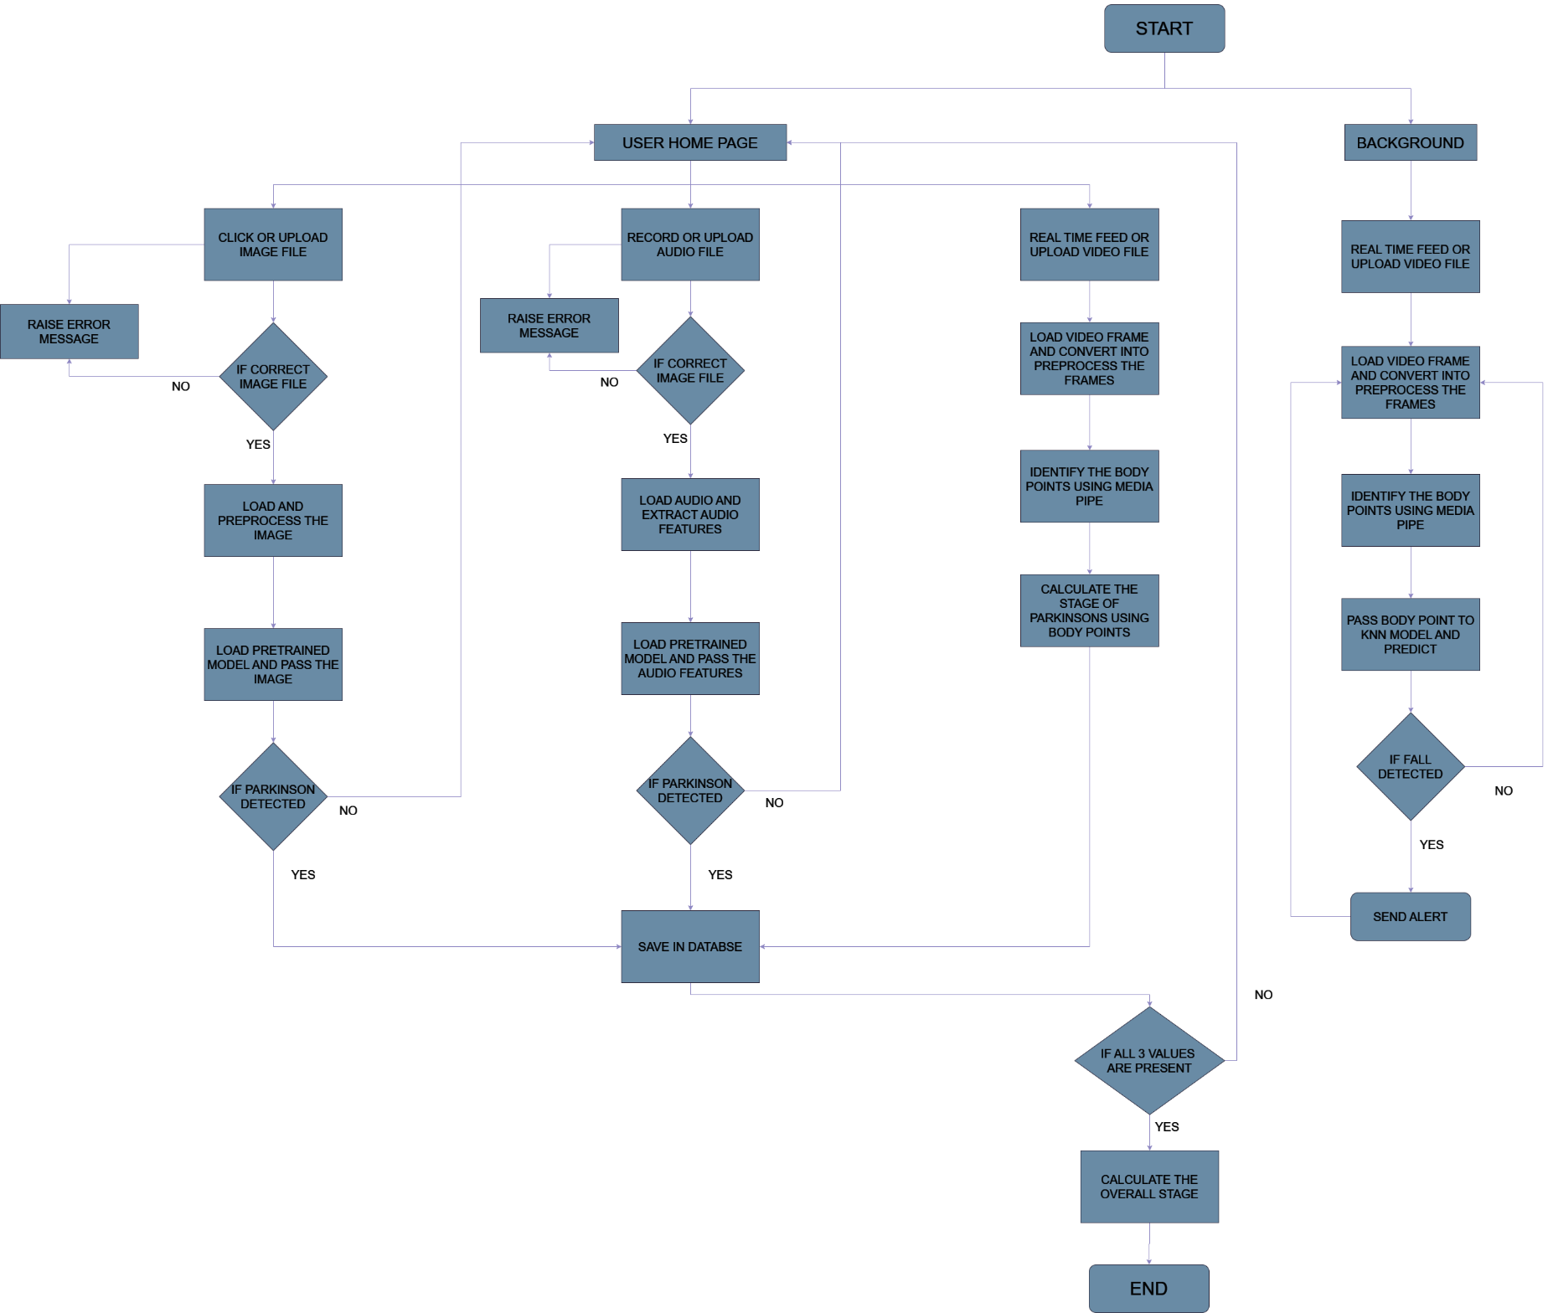
FLOW CHART

Slide 13
Data and Machine learning

Slide 14

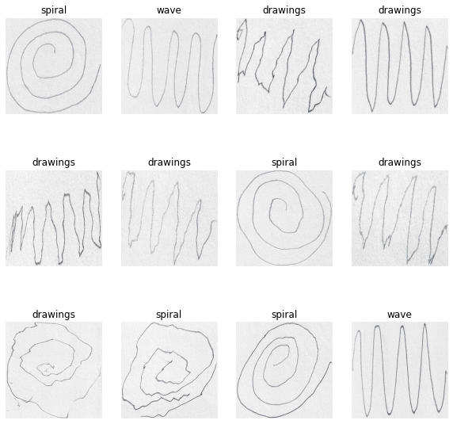
Machine Learning Model : Data Collection
Handwriting database consists of 62 PWP(People with Parkinson) and 15 healthy individuals. The data was collected in 2009.
Number of instances: 77, Number of attributes: 7

Slide 15
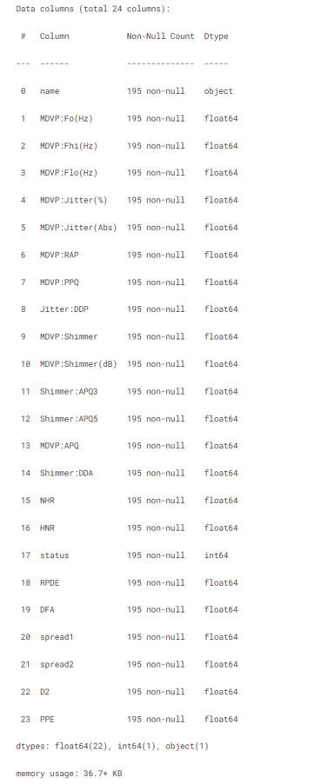
Machine Learning Model : Data Collection
Matrix column entries (attributes): name - ASCII subject name and recording number MDVP:Fo(Hz) - Average vocal fundamental frequency MDVP:Fhi(Hz) - Maximum vocal fundamental frequency MDVP:Flo(Hz) - Minimum vocal fundamental frequency MDVP:Jitter(%),MDVP:Jitter(Abs),MDVP:RAP,MDVP:PPQ,Jitter:DDP - Several measures of variation in fundamental frequency MDVP:Shimmer,MDVP:Shimmer(dB),Shimmer:APQ3,Shimmer:APQ5,MDVP:APQ,Shimmer:DDA - Several measures of variation in amplitude NHR,HNR - Two measures of ratio of noise to tonal components in the voice status - Health status of the subject (one) - Parkinson's, (zero) - healthy RPDE,D2 - Two nonlinear dynamical complexity measures DFA - Signal fractal scaling exponent spread1,spread2,PPE - Three nonlinear measures of fundamental frequency variation

Slide 16
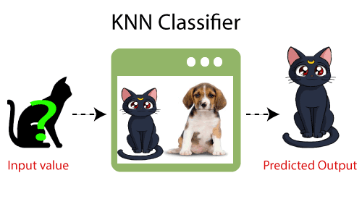
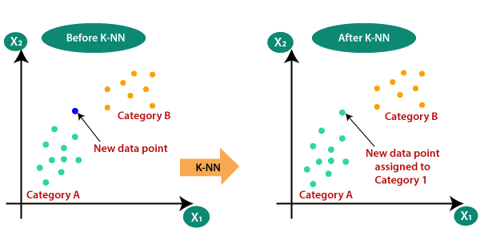
Machine Learning Algorithm : KNN
K-Nearest Neighbour is one of the simplest Machine Learning algorithms based on Supervised Learning technique.
K-NN algorithm assumes the similarity between the new case/data and available cases and put the new case into the category that is most similar to the available categories.
K-NN algorithm stores all the available data and classifies a new data point based on the similarity. This means when new data appears then it can be easily classified into a well suite category by using K- NN algorithm.
K-NN algorithm can be used for Regression as well as for Classification but mostly it is used for the Classification problems.
K-NN is a non-parametric algorithm, which means it does not make any assumption on underlying data.

Slide 17
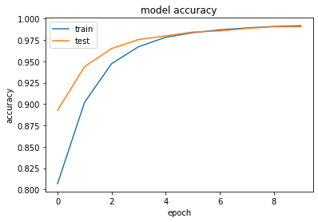
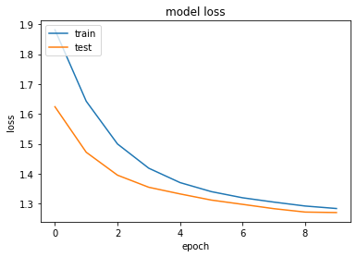
Machine Learning Model : Data Collection
Training accuracy: 98.2%
Validation Accuracy: 96.8%

Slide 18
OUTPUTS

Slide 19
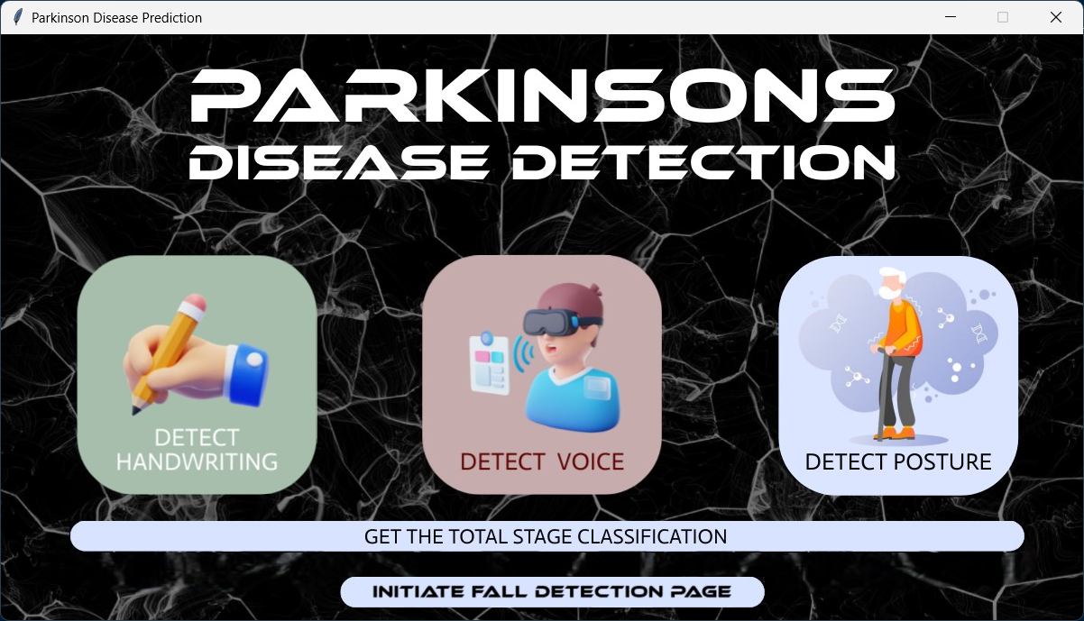
SOFTWARE PAGES
- A welcoming header that introduces the user to the application, setting a positive and inviting tone.
Multiple buttons to curate different needs
A button to Initiate fall detect app
Another buttons for moving to handwriting detection
Next button to move to audio based detection
And another button to move to Video based detection
And at last a button to calculate overall stage of the Parkinson's

Slide 20
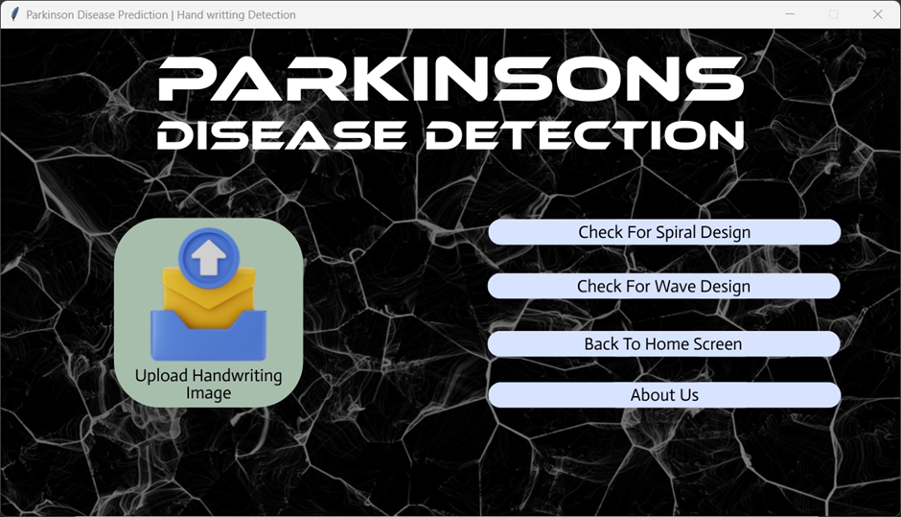
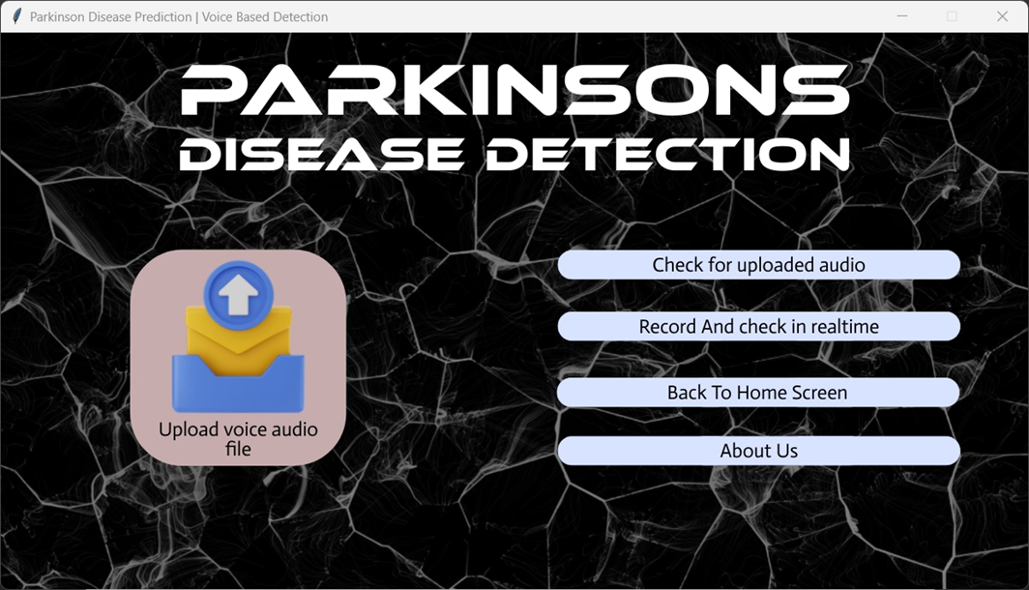
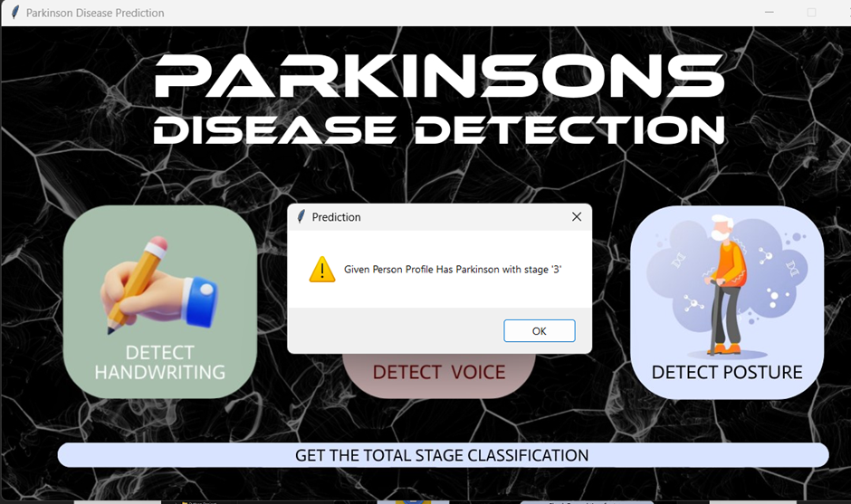
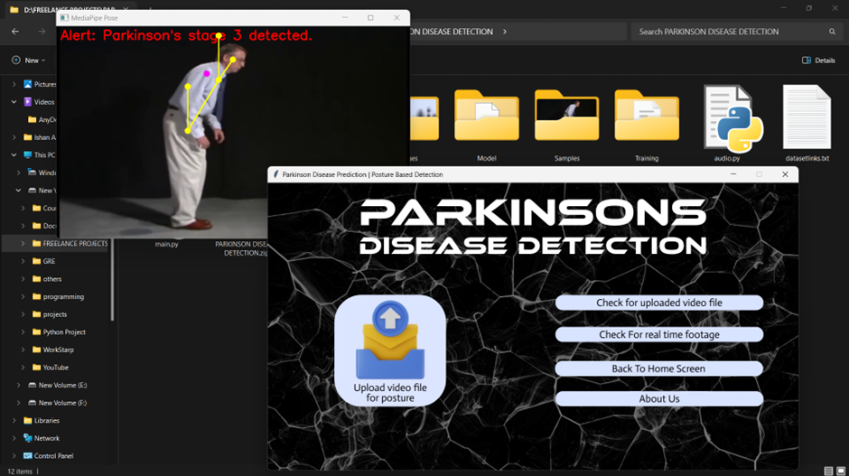
OTHER PAGES

Slide 21
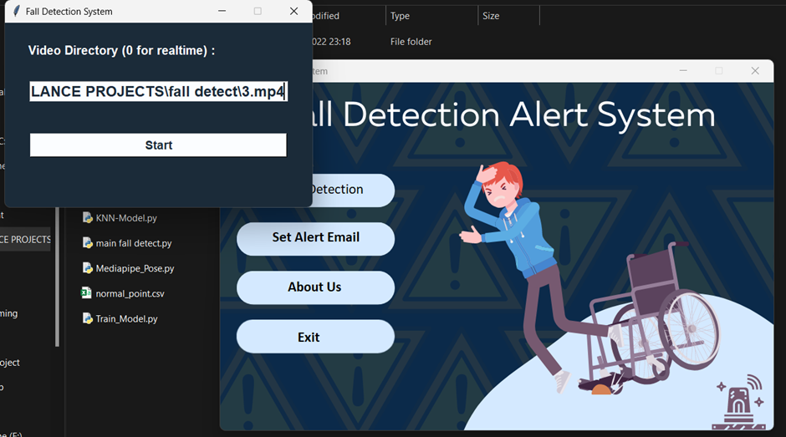
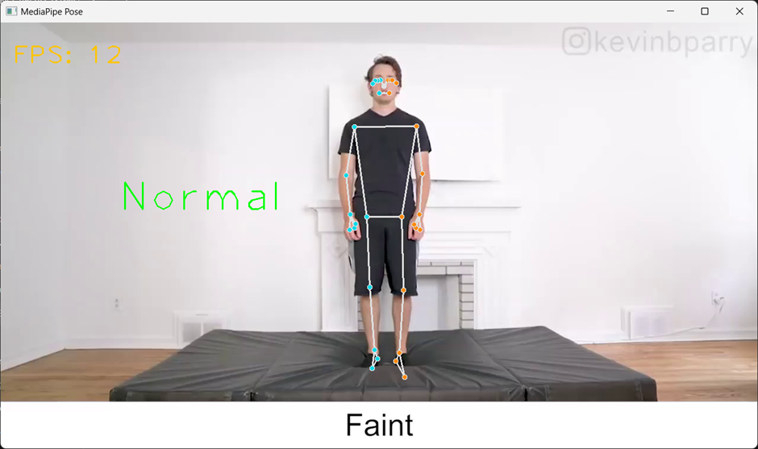
FALL DETECTION PAGE

Slide 22
THANK YOU

